Slide 1
Sprint 2
Alzheimer's Facial Recognition
Gabriel Thomas, Irald kollcinaku, Robert Turczyn, Tyler Schauss, Jacob Carpenter, Zilin Li

Slide 2
Vision Statement
Our vision is to build a bridge between humans and machines through software technology. Through a skilled team of developers, we acknowledge the need for a change in medical conditions that affect not only the patients but also their loved ones. Our team strives to build a superior app to empower Alzheimer's patients recognize people in their daily routine.
Incorporating facial recognition, tracking and reminders is our main focus in constructing this helpful app.

Slide 3
Challenges
Time management
Becoming familiar with PWA apps
Differences with applications between mac and windows
Understanding our desired tech stack
Effectively organizing workload
Future
Ensuring long-term battery life to the device
Facial recognition accuracy
Lighting conditions and age affecting recognition

Slide 4
Mitigation Plan
Minimum one scheduled face-to-face meeting, with multiple online meetings throughout the week.
Keeping open options on our facial detection and recognition software. May pursue using an android SDK provided by Arcsoft if we cannot implement OpenCV
Keep screen dimming until client start to use this application.
Continuing to update the risk mitigation plan in the following development life cycle.

Slide 5
User Stories
1. As a user, I want to see a colorful & interesting home screen, so that I am drawn into using the app.
2. As a user, I want the app to run smoothly, so that I do not experience any glitches.
3. As a user, I want to be able to input my name and a password to login.
4. As a user, I want to be able to capture faces through the camera.
5. As a user, I want to upload and tag pictures into my library.
6. As a user, I want to see and listen to the information of the identified person, so I can memorize them.
7. As a user, I want to record the information of the identified person, so I can re-access it at a later period.
8. As a user, I want the app to automatically recognize people in my album.
9. As a user, I want to personalize my notifications.
10. As a user, I want to be able to navigate through the app efficiently.

Slide 6
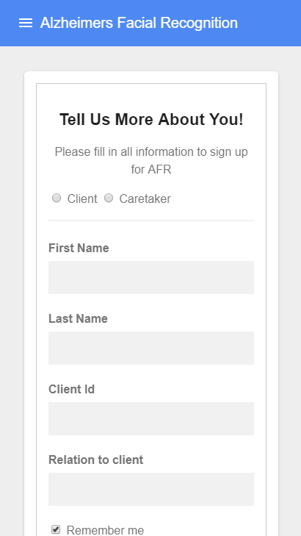
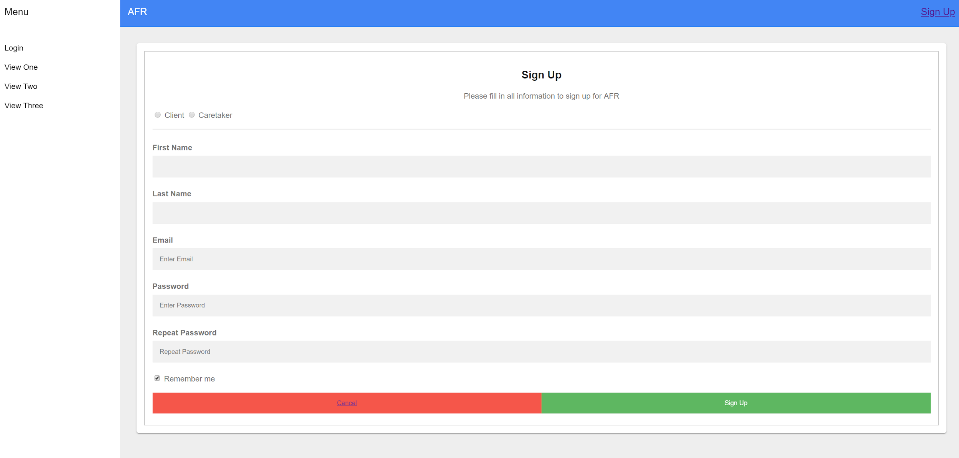
User Authentication

Slide 7
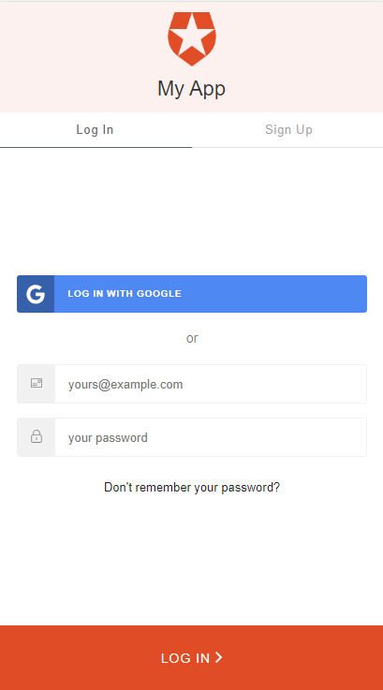
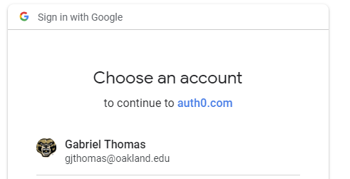
User Authentication continued

Slide 8
QA Test Example
Test Case #: <TC-2> System: Login | Test Case Name: Login Check
Designed by: Irald | Subsystem: N/A
Executed by: Zllin | Design Date: 9/21/18
Short description: Make you are able to login | Execution Date: 9/21/18
Step | Action | Expected System Response | Pass/Fail | Comments/Actual Result
1. | User opens the application | Application opens and user clicks login | Pass | App opens
2. | User enters in information after login screen loads | User is able to enter their information into the login page | Pass | Info can be entered
3. | User hits login | System checks credentials with database and if correct logins into their account | Pass | Logs into user’s account
Pre-condition
User has an account for the application and wants to log back into it..

Slide 9
Upcoming Objectives
Setup a Firebase hosted server
Will host NoSQL Database
Will hold data for client’s contacts
Will hold images of client’s contacts
Use the device camera to achieve facial recognition
Utilize text to speech with facial recognition
Will tell client the recognized contact’s information
Allow clients to upload images and data of contacts
Allow caretakers to upload images and informations that is connected to a client’s account
Use PWA to create a web portal as well as Android and iOS apps
Possible implement a location setting that can show the location of a client to a caretaker.
Further CSS styling to make app look unique

Slide 10
Demo!

